Slide 1
Machine learning

Slide 2

Based slides on material from and images from:
Artificial Intelligence, a modern approach, Stuart Russell and Peter Norvig.
Deep Learning, Ian Goodfellow and Yoshua Bengio and Aaron Courville. http://www.deeplearningbook.org
Python Machine Learning - Sebastian Raschka www.machinelearningmastery.com

Slide 3
Prerequisites
Linear Algebra Mathematical optimisation
General programming, preferably Python

Slide 4
Lecture 1
Introduce ML
Supervised vs unsupervised learning. Linear regression example
Neurons
Motivating Deep learning

Slide 5
Lecture 2
Deep learning XOR example Forward feed Backfitting
Learning vs pure optimization CNN

Slide 6
Lecture 3
Real life applications / Current research Start discussing labs

Slide 7
Lecture 1

Slide 8



Introduction
Even the ancient Greeces dreamt of thinking machines
They were thinking fully alive automatons. Now we are thinking of making use of our programmable computers.
Artificial intelligence (AI) is a huge field
Trying to develop software to automate “simple” labour Speech and image recognition

Slide 9

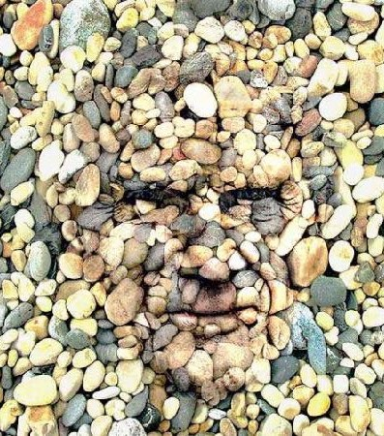
Introduction
Initially computers were used to solve complicated for humans but straight forward mathematical problems.
Challenge now is understanding the softer issues, easy/intuitive for humans such as recognising “hidden images” or dialects.
https://www.moillusions.com/wp-content/uploads/2007/06/ hiddenman-580x504.jpg

Slide 10
Introduction
The present solution is to allow computers to learn from experience and to understand things as concepts with each concept defined in relation to simpler concepts.
From this, using layers of layers of layers of concepts we get the approach of AI deep learning.
By gathering knowledge from experiences there is a method that avoids the need for humans to formally specify all of the needed knowledge.
Imagine how any program with enough if statements could be considered intelligent.

Slide 11
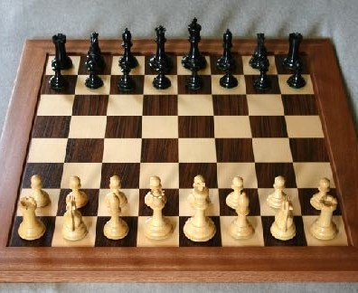
Introduction
Many early AI projects, for instance deep blue (Chess) did not know anything about the “world”.
Chess can be completely described with a short list of formal rules.
Similar thing with GO!
We want to move away from this box and go to things closer to human life.
Requiring information, knowledge and intuition.
Also difficult to write up formally. Key challenge.

Slide 12
Introduction
Ai needs the ability to acquire knowledge, patterns from raw data. This is known as Machine learning.
Can now teach computers knowledge of the real world and make seemingly subjective decisions.
Logistic regression -> Medical decision making. Naive Bayes, spam filtering
Requires representation of data, each provided feature
These methods can not understand a picture, but can understand a technical report.
Pixels do not have as big a correlation.

Slide 13
Introduction
One thing to never forget is the representation.
If the data is easily accessible, computers can collect it exponentially faster than having to type it in.
Handle numbers vs strings, names vs bank id.
Compare voice samples or use samples to estimate size of vocal cords? Very difficult to know a priori, identify cars by wheels or pixels?
Is it a wheel or a shadow? Same at night as daytime?

Slide 14

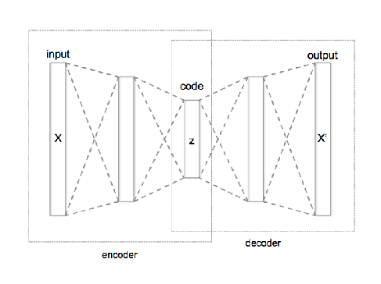
Introduction
One solution, use machine learning for representation.
Representation learning, unsupervised
Think sudo inverse, get as much information with as simple a representation.
Autoencoder, both encoder and decoder.
Trained to preserve as much information as possible.

Slide 15
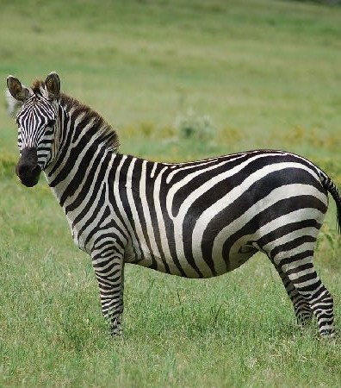
Introduction
Another difficulty, many factors or variation in real world applications.
Think we can use images to classify horses vs zebras
How handle variations in images?
Angle, shape, size?

Slide 16

Introduction
Almost as hard to find representation as solving the problem.
Deep learning lets us express difficult representations as simpler representations.
However, not always needed, could be too complicated for what we are trying to do.
Could simply need a rotation or mapping.

Slide 17
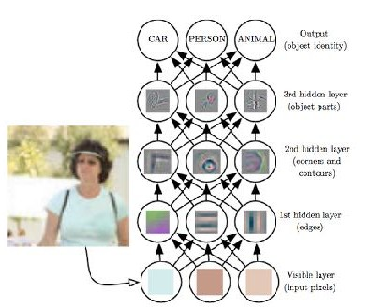
Introduction
Illustrating how a deep neural net can identify an image.
Raw data is just pixels. Perhaps impossible to tackle straight away.
Use several different simpler mappings in each net.
Notation, visible and hidden layers.
What we can “observe” vs internal data layers and not directly seen in the output.

Slide 18
Introduction
First layer finds edges by using brightness.
Using corners, contours can be found as several edges.
Using edges, can start looking finding objects.
With objects, an easier task to classify.

Slide 19
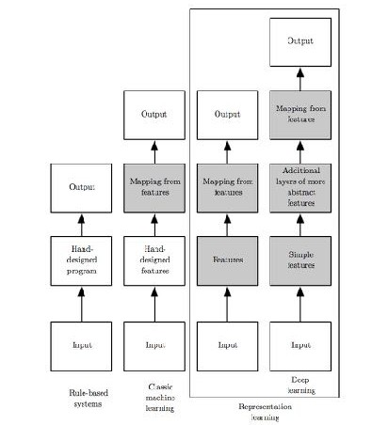
Introduction
How different parts relate to each other.
Difference between models and planning.
Shaded boxes are where we learn from data.

Slide 20

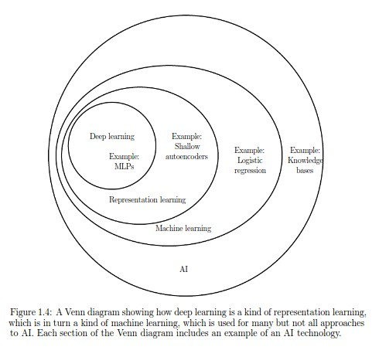
ML vs Ai - http://www.deeplearningbook.org

Slide 21
Don’t forget
Logistic Regression (LR) is classified under Machine Learning (ML). One should not use Deep Learning (DL) for every possible problem.
Don’t use Machine Learning (ML) or Deep Learning (DL) if you can write a simple program to solve the problem: Using ML or DL for such a problem will be inaccurate or very inefficient
Always start with simple models before moving to complex once: Complex models have too many free parameters. It is very difficult to know how they will behave in unexplored cases.
Don’t use DL if the problem is simple or if you get sufficient accuracy with a ML model: DL models are complex. Using DL for a simple problem is an overkill, the model will be inefficient
Don’t use DL if you have small amount of data: You can’t train a DL model with small amount of data. The results will be really bad.
Best situation is a lot of data with few very distinct parameters. This is not a magical method that solvs all problems.

Slide 22
Practically
A machine learning algorithm is an algorithm that is able to learn from data.
But what do we mean by learning?
“A computer program is said to learn from experience E with respect to some class of tasks T and performance measure P, if its performance at tasks in T, as measured by P, improves with experience E.”

Slide 23
Task T
Classification (With missing input)
Regression
Transcription (Find structure in text) Machine translation
Parsing
Anomaly detection
Generators/Predictions of missing values/Denoising Density estimators

Slide 24


Performance P
Measure accuracy, proportion of examples of correct output vs incorrect.
Can also output error rate as 0-1 loss.
However all this needs to be performed on data that the algorithm was not trained on to give a good estimate.
Can be quite difficult choosing the right performance index in some cases.

Slide 25
Experience E
Unsupervised vs Supervised
Want to find clusters, unknown patterns. Known pattern, want to classify.

Slide 26

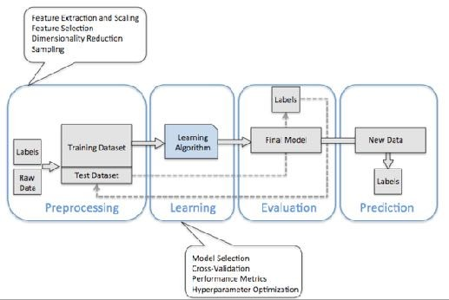

How do we do it?
Splitting data into Training, Testing and “Real”.
Training used for the algorithm
Testing to evaluate
“Real” is yet unclassified data

Slide 27
Hopefully you now have an idea of the background Lets move on to an example:
Learning linear regression on the board
Have the notes in the slides as well

Slide 28
Linear regression is a very simple and limited example of ML
It shows the how an algorithm can work and shows the basic principles.
It also shows fundamentally what ML actually is.

Slide 29
Task: Given a vector (position of our points) x, predict output y on the form : y_{pred} = w~ ^{T} ~x
Where w is our fitting parameters. Think of them weighing features w.r.t. predictions.
How do we evaluate performance? In this example, evaluate the test set using MeanSquaredError:
1
t~est
_{— y}t~est|²
MSE =
|y
test
m
pred

Slide 30

In our example we can simply derive our best W, only on
train data.
W MSEtrain = 0
train
1
! r
|y
— ytrainMSEtrain = 0
W
m
pred
1
! rW _{m}|Xtrain — ytrain| = 0
! r_{W} (w
T T T _{X}T T
train train^{y}train ^{+ y}train^{y}train⁾ ⁼ ⁰
X X w — 2w
train
! 2X
T
train
X w — 2X
T
train
y = 0
train
train
! w = (X
^{T} Xtrain)^{—1}X^{T} ytrain train train
This may not seem like learning, but it is! Learn about w.

Slide 31
We have to assume training error is expected test error.
Assume this by assuming sampling from the same set.
Have to ensure that they are both large enough samples.
Thus minimising MSE train should be the same as minimising MSE test.

Slide 32
This leads to two different problems, underfitting and overfitting.
Essentially the gap between training and test error. Relating to our example, limit the order of the equation. Remember any linear curve fitting you’ve ever done.

Slide 33
A big problem in ML when is trying to work with to few data points.
Easiest solution is to preprocess the data, combine features.
Too many data points, could be missing a feature, some underlaying assumption/variable.

Slide 34
Logistical regression, y = 1 if < some w.
from our line given
How do we improve? Stochastic Gradient Descent
Normal optimisation method, think Newton-Ralphson Step depending on derivative of error loss function.

Slide 35
How improve data from test?
In general, total error is J for a parameter theta
m
1
X
J(✓) = E L(x, y, ✓) =
(i) (i)
L(x , y , ✓)
x,y pˆ_{data}
m
i=1
For an example loss function
L(x, y, ✓) = —logp(y|x; ✓)
Could also be our MSE.

Slide 36
Thus, derive wrt W or theta.
m
1
X
r J(✓) =
r L(x
(i) (i)
, y , ✓)
✓
m
✓
i=1
In our fixed mini batch M’, assuming it is representativ of M.
_{m}0
1
X
g =
r L(x
(i)_{, y}(i)_{, ✓)}
_{m}0
✓
i=1
Improve parameter theta by stepping with some size e
✓ ✓ — ✏g

Slide 37

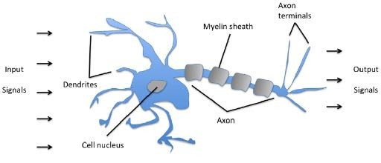
Neurons
For some input x
Create Z with weight W as Z
=W^T*Z
Return 1 if Z> U Else return 0 or -1
U is the threshold
Usually implemented with the heavy side function.

Slide 38
Neurons
Can put these in a chain
Can throw the threshold into w0 = -U and x0 = 1 Steps:
Initialize all the weights to 0 or small random numbers
For each sample x, Compute output value \hat{y}, update the weights given expected y.
w_{j} = w_{j} + ⌘(y
(i) (i)
— yˆ )x
(i)
j
eta is the learning rate, some value in range {0,1}

Slide 39

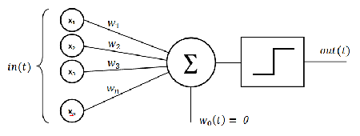
Perceptrons
Find some features
Our example quite simple, only one feature. one layer.
Either “fire” or doesn’t.
Will walk through a simple code version.

Slide 40
Example of perceptron with data.
You will implement this for the iris data set
Based on Python Machine Learning - Sebastian Raschka

Slide 41
Deep learning
What happens if we set several neurons after each other?
Good place to stop for today.

Slide 42
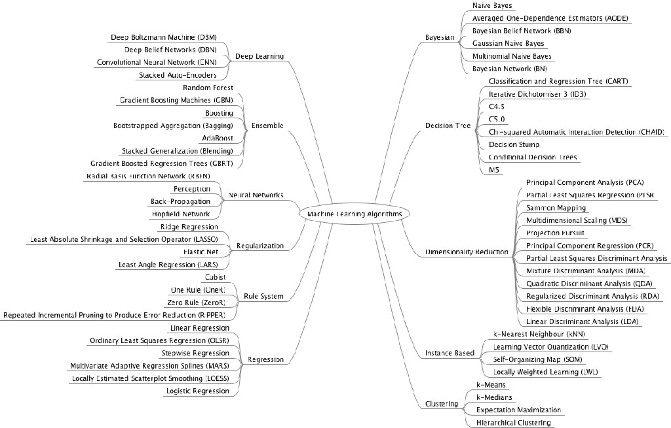

Slide 43
Any questions?
Otherwise just approach me at any time or send me an email. p.hallsjo.1@research.gla.ac.uk

Slide 44
End lecture 1

Slide 45
Lecture 2

Slide 46
Lecture 2
Deep learning Forward feed XOR example
Universal approximation Back-propagation
Learning vs pure optimization CNN

Slide 47
I will not talk about optimisation.
Too problem specific, will just give an overview and how to use it.
See more in for instance the deep learning book.

Slide 48
Deep learning
Deep learning lets us express difficult representations as simpler representations.
Goal is approximate a function f which maps input x to a category y given parameters m (theta)
Networks, given that often we have f(g(h(x))). The chain is denoted depth.

Slide 49
Deep learning
Deep feedforward networks, same as multilayer preceptrons. Several of what we used in last lecture.
Hidden layers since can not directly see output due to layer.
Feedforward, information flows through the function being evaluated from x, through the intermediate computations used to define f, and finally to the output y.
There are no feedback connections in which outputs of the model are fed back into itself.
When feedforward neural networks are extended to include feedback connections, they are called recurrent neural network.

Slide 50
Deep learning
Finally, these networks are called neural because they are loosely inspired by neuroscience.
Each hidden layer of the network is typically vector-valued.
The dimensionality of these hidden layers determines the width of the model.
Each element of the vector may be interpreted as playing a role analogous to a neuron.
Rather than thinking of the layer as representing a single vector-to- vector function

Slide 51
Deep learning
We can also think of the layer as consisting of many units that act in parallel, each representing a vector-to-scalar function.
Each unit resembles a neuron in the sense that it receives input from many other units and computes its own activation value. Analogy with neuroscience.
The choice of the functions f^{(i)}(x) used to compute these representations is also loosely guided by neuroscientific observations about the functions that biological neurons compute.
However, modern neural network research is guided by many mathematical and engineering disciplines, and the goal of neural networks is not to perfectly model the brain.
It is best to think of feedforward networks as function approximation machines that are designed to achieve statistical generalization, occasionally drawing some insights from what we know about the brain, rather than as models of brain function.

Slide 52
Deep learning
One way to understand feedforward networks is to begin with linear models and consider how to overcome their limitations.
Linear models, such as logistic regression and linear regression, are appealing because they may be fit efficiently and reliably.
Linear models also have the obvious defect that the model capacity is limited to linear functions, so the model cannot understand the interaction between any two input variables.

Slide 53
Deep learning
Think of a linear model, but being extended to apply the model to not x, but f(x) where f(x) is just a mapping.
Many initial methods did this. Choose a generic f, if it has high enough dimension it can fit the training set. But generalisation is poor.
Often manually generate f, requires human effort. Before deep learning.

Slide 54


Deep learning
Deep learning aims to learn this initial y=f(x;θ,w)=
ɸ(x;θ)w mapping.
Use θ and learn ɸ from a broad class of functions, have w for mapping.
This is an example of a deep feedforward network with
ɸ as a hidden layer.
One of many approaches, more benefits than difficulties.

Slide 55


Deep learning
Parametrise ɸ(x;θ) and use optimisation to find θ for a good representation.
Use a broad family of functions, ɸ(x;θ), to make the approach generic.
Gives us the advantage that it is simpler to fine a family of functions than precisely the right function.

Slide 56
XOR example
Have the notes in the slides as well

Slide 57
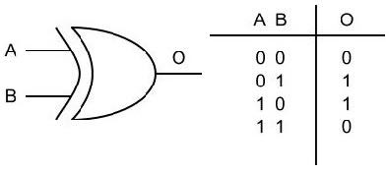
Example
Definitely not linear
XOR image from http://
www.vlsiinterviewquesti ons.org/wp-content/ uploads/2012/04/xor.jpg

Slide 58
Take loss function J = 1/4 MSE(m)
f(x,w,b) = x^T w + b, does not work Choose y = f(h,w,b), with h = g(x^T W + c)
Default recommendation, use the max function.
This activation function is the default activation function recommended for use with most feedforward neural networks

Slide 59
Close to linear, but lets us move to nonlinearity.
Thus, our network is taken as: y=f(x;W,c,w,b) = w^T max{0,W^t x +c } + b
Thus our m is composed of W,c,w,b and will need to be trained through J.

Slide 60


Could work through, should start with random values
For XOR, take W = [ 1 1 ; 1 1], c = [0 ; 1], w = [1, -2] and
b =0
Let walkthrough for binary input: X = [0 0 ; 0 1 ; 1 0 ; 1 1]
If not good, could use our normal gradient decent for all m variables, W, c, w, b
Minimise all of the derivatives.
Bonus, have developed xor model for non binary input!

Slide 61
Gradient decent
As we can see, designing and training a neural net is not much different from any other method using gradient decent.
It requires an optimisation, cost function and a model family.
The largest difference between linear models and neural networks
Nonlinearity of a neural network causes most interesting loss functions to become non-convex.

Slide 62
Gradient decent
This means that neural networks are usually trained by using iterative, gradient- based optimisers that merely drive the cost function to a very low value.
Compare to linear equation solvers used to train linear regression models or the convex optimisation algorithms with global convergence guarantees used to train logistic regression or SVMs.
Convex optimisation converges starting from any initial parameters (in theory— in practice it is very robust but can encounter numerical problems).
Stochastic gradient descent applied to non-convex loss functions has no such convergence guarantee, and is sensitive to the values of the initial parameters.
For feedforward neural networks, it is important to initialise all weights to small random values. The biases may be initialised to zero or to small positive values.

Slide 63
Gradient decent
For the moment, it suffices to understand that the training algorithm is almost always based on using the gradient to descend the cost function in one way or another.
Linear models can also be trained with gradient decent Common when the training set is large.
Training a neural network is not much different, but gradient computation is more complex.

Slide 64
Hidden units
The design of hidden units is an extremely active area of research and does not yet have many definitive guiding theoretical principles.
Rectified linear units (RLUs) are an excellent default choice of hidden unit. Examples are the max(0,x) function
Many other types of hidden units are available. Essentially anything that goes from -1 to 1, tanh(x)
It is usually impossible to predict in advance which will work best.
The design process consists of trial and error, intuiting that a kind of hidden unit may work well, and then training a network with that kind of hidden unit and evaluating its performance on a validation set.

Slide 65
Hidden units
Hidden units do not, as you may assume be differentiable at all input points.
For example, the rectified linear function g (z) = max{0, z} is not differentiable at z = 0.
This may seem like it invalidates g for use with a gradient- based learning algorithm.
In practice, gradient descent still performs well enough for these models to be used for machine learning tasks.
This is in part because neural network training algorithms do not usually arrive at a local minimum of the cost function, but instead merely reduce its value significantly.

Slide 66
Hidden units
Because we do not expect training to actually reach a point where the gradient is 0, it is acceptable for the minima of the cost function to correspond to points with undefined gradient.
A function is differentiable at z only if both the left derivative and the right derivative are defined and equal to each other.
The functions used in the context of neural networks usually have defined left derivatives and defined right derivatives.
In the case of g(z) = max{0, z}, the left derivative at z = 0 is 0 and the right derivative is 1.

Slide 67
Hidden units
Software implementations of neural network training usually return one of the one- sided derivatives rather than reporting that the derivative is undefined or raising an error.
This may be heuristically justified by observing that gradient-based optimisation on a digital computer is subject to numerical error anyway.
The important point is that in practice one can safely disregard the non- differentiability of the hidden unit
Deeper networks often are able to use far fewer units per layer and far fewer parameters and often generalise to the test set, but are also often harder to optimise.
The ideal network architecture for a task must be found via experimentation guided by monitoring the validation set error.

Slide 68
Universal approximation
A linear model, mapping from features to outputs via matrix multiplication, can by definition represent only linear functions.
It has the advantage of being easy to train because many loss functions result in convex optimisation problems when applied to linear models.
Unfortunately, we often want to learn nonlinear functions.
At first glance, we might presume that learning a nonlinear function requires designing a specialised model family for the kind of nonlinearity we want to learn.
Fortunately, feedforward networks with hidden layers provide a universal approximation framework.

Slide 69
Universal approximation
Specifically, the universal approximation theorem states that a feedforward network with a linear output layer and at least one hidden layer with any activation function can approximate any Borel measurable function from one finite-dimensional space to another with any desired non-zero amount of error, provided that the network is given enough hidden units.
This also holds for the derivatives.
Any continuous function on a closed and bounded subset of R^{n} is Borel measurable and therefore may be approximated by a neural network.

Slide 70
Universal approximation
A neural network may also approximate any function mapping from any finite dimensional discrete space to another.
Universal approximation theorems have also been proved for a wider class of activation functions, even RLUs
The universal approximation theorem means that regardless of what function we are trying to learn, we know that a large MLP will be able to represent this function.
This does not guarantee that the algorithm can learn the function, only represent.

Slide 71
Universal approximation
Even if the MLP is able to represent the function, learning can fail for two different reasons.
The optimisation algorithm used for training may not be able to find the value of the parameters that corresponds to the desired function.
We get the same issues in neural net optimisation as any other optimisation problem, local minima, saddle points etc.
The training algorithm might choose the wrong function due to overfitting.
There is no free lunch, there is no universally superior machine learning algorithm.
Feedforward networks provide a universal system for representing functions, in the sense that, given a function, there exists a feedforward network that approximates the function.
There is no universal procedure for examining a training set of specific examples and choosing a function that will generalise to points not in the training set.

Slide 72
Universal approximation
The universal approximation theorem says that there exists a network large enough to achieve any degree of accuracy we desire, but the theorem does not say how large this network will be.
Unfortunately, in the worse case, an exponential number of hidden units may be required.
In summary, a feedforward network with a single layer is sufficient to represent any function, but the layer may be infeasibly large and may fail to learn and generalise correctly.
In many circumstances, using deeper models can reduce the number of units required to represent the desired function and can reduce the amount of generalisation error.

Slide 73
Back-propagation
Feels more intuitive to use the cost to calculate the derivative directly.
In essence, we use the chain rule to traverse our whole network.
When we use a feedforward neural network to accept an input x and produce an output y, information flows forward through the network.
The inputs x provide the initial information that then propagates up to the hidden units at each layer and finally produces y.
During training, forward propagation can continue onward until it produces a scalar cost J(θ).

Slide 74
Back-propagation
The back-propagation algorithm allows the information from the cost to then flow backwards through the network, in order to compute the gradient.
Computing an analytical expression for the gradient is straightforward, but numerically evaluating such an expression can be computationally expensive.
The back-propagation algorithm does so using a simple and inexpensive procedure.
Back-propagation refers only to the method for computing the gradient, while another algorithm, such as stochastic gradient descent, is used to perform learning using this gradient.
Furthermore, back-propagation is often misunderstood as being specific to multi- layer neural networks, but in principle it can compute derivatives of any function.

Slide 75
Back-propagation
Specifically, we will describe how to compute the gradient ∇_{x} f( x, y) for an arbitrary function f , where x is a set of variables whose derivatives are desired, and y is an additional set of variables that are inputs to the function but whose derivatives are not required.
In learning algorithms, the gradient we most often require is the gradient of the cost function with respect to the parameters, ∇J(θ).
Many machine learning tasks involve computing other derivatives, either as part of the learning process, or to analyse the learned model.
The back-propagation algorithm can be applied to these tasks as well, and is not restricted to computing the gradient of the cost function with respect to the parameters.

Slide 76

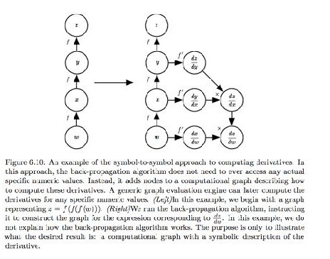
Back-propagation
The back-propagation algorithm is very simple. To compute the gradient of some scalar z with respect to one of its ancestors x in the graph, we begin by observing that the gradient with respect to z is 1.
We can then compute the gradient with respect to each parent of z in the graph by multiplying the current gradient by the Jacobian of the operation that produced z.
We continue multiplying by Jacobians traveling backwards through the graph in this way until we reach x.
For any node that may be reached by going backwards from z through two or more paths, we simply sum the gradients arriving from different paths at that node.

Slide 77
Summary
From this point of view, the modern feedforward network is the culmination of centuries of progress on the general function approximation task.
Following the success of back-propagation, neural network research gained popularity and reached a peak in the early 1990s. Afterwards, other machine learning techniques became more popular until the modern deep learning renaissance that began in 2006.
The core ideas behind modern feedforward networks have not changed substantially since the 1980s. The same back- propagation algorithm and the same approaches to gradient descent are still in use.
Most of the improvement in neural network performance from 1986 to 2015 can be attributed to two factors.
First, larger datasets have reduced the degree to which statistical generalisation is a challenge for neural networks.
Second, neural networks have become much larger, due to more powerful computers, and better software infrastructure. However, a small number of algorithmic changes have improved the performance of neural networks noticeably.
One of these algorithmic changes was the replacement of mean squared error with the cross-entropy family of loss functions. Mean squared error was popular in the 1980s and 1990s, but was gradually replaced by cross-entropy losses and the principle of maximum likelihood as ideas spread between the statistics community and the machine learning community.

Slide 78
Optimisation vs training
Optimisation algorithms used for training of deep models differ from normal optimisation.
Machine learning usually acts indirectly.
In most machine learning scenarios, we care about some performance measure P, that is defined with respect to the test set.
We therefore optimise P only indirectly. We reduce a different cost function J(θ) in the hope that doing so will improve P.
This is in contrast to pure optimisation, where minimising J is a goal in and of itself.
Optimisation algorithms for training deep models also typically include some specialisation on the specific structure of machine learning objective functions.

Slide 79



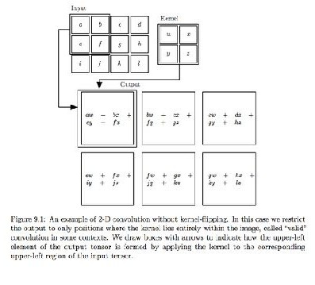
Convolutional Networks, CNN
Convolutional neural networks or CNNs.
Specialised kind of neural network for processing data with a, grid-like topology.
Time-series data, 1D grid taking samples at regular time intervals
Image data, a 2D grid of pixels.
Convolutional networks have been tremendously successful in practical applications.
Convolutional networks are simply neural networks that use convolution in place of general matrix multiplication in at least one of their layers.

Slide 80

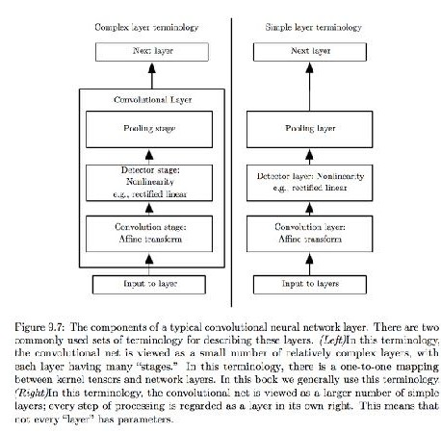
Convolution leverages three important ideas that can help improve a machine learning system: sparse interactions, parameter sharing and equivalent representations.
CNN
Moreover, convolution provides a means for working with inputs of variable size.
Traditional neural network layers use matrix multiplication by a matrix of parameters with a separate parameter describing the interaction between each input unit and each output unit.
This means every output unit interacts with every input unit.
Convolutional networks, however, typically have sparse interactions This is accomplished by making the kernel smaller than the input.
For example, when processing an image, the input image might have thousands or millions of pixels, but we can detect small, meaningful features such as edges with kernels that occupy only tens or hundreds of pixels.

Slide 81
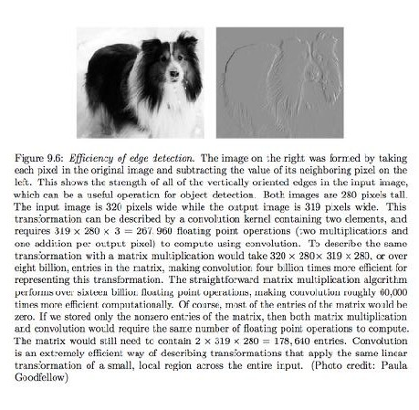
Store fewer parameters, which both reduces the memory requirements of the model and improves its statistical efficiency.
CNN
It also means that computing the output requires fewer operations.
These improvements in efficiency are usually quite large
For many practical applications, it is possible to obtain good performance on the machine learning task while keeping several orders of magnitude less data.
This allows the network to efficiently describe complicated interactions between many variables by constructing such interactions from simple building blocks that each describe only sparse interactions.

Slide 82
Any questions?
Otherwise just approach me at any time or send me an email. p.hallsjo.1@research.gla.ac.uk

Slide 83
End lecture 2

Slide 84
Lecture 3

Slide 85
Lecture 3
Real life applications / Current research Start discussing labs

Slide 86

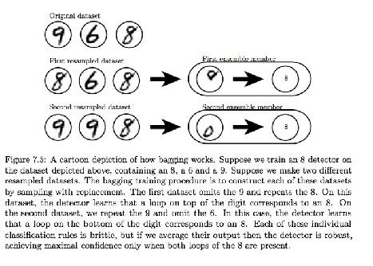
Bootstrap aggregating
Bagging, bootstrap aggregating
Reduces generalisation errors. Combine several methods.
Train several models separately, then combine for final result.

Slide 87

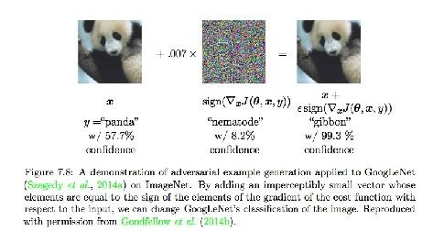
Adversarial training
In many cases, neural networks have begun to reach human performance.
Wonder whether these models have obtained a true human-level understanding of these tasks.
In order to probe the level of understanding a network has of the underlying task, we can search for examples that the model misclassifies.
Neural networks that perform at human level accuracy have a nearly 100% error rate on examples that are intentionally constructed by using an optimisation procedure, seen in figure.
Adversarial examples have many implications, for example, in computer security.
However, they are interesting in the context of regularisation because one can reduce the error rate on the original i.i.d. test set via adversarial training.
Adversarial training discourages this highly sensitive locally linear behaviour by encouraging the network to be locally constant in the neighbourhood of the training data.

Slide 88
Online applications
Give some specific problems and solutions, computer vision.
How do we deal with images? Pixel by pixel. Neural nets give images.
Great link http://playground.tensorflow.org/

Slide 89
Online applications
ConvNetJS is a Javascript library for training Deep Learning models (Neural Networks) entirely in your browser. Open a tab and you're training. No software requirements, no compilers, no installations, no GPUs, no sweat.
https://cs.stanford.edu/people/karpathy/convnetjs/

Slide 90
Online applications
How do we apply our knowledge to time series? One good tutorial for how to do it in tensorflow.
https://mapr.com/blog/deep-learning-tensorflow/
https://en.wikipedia.org/wiki/ Autoregressive_integrated_moving_average
https://www.analyticsvidhya.com/blog/2016/02/time- series-forecasting-codes-python/

Slide 91
Online applications
https://www.kaggle.com/patha325/titanic-data- science-solutions
https://www.kaggle.com/patha325

Slide 92
https://youtu.be/l_owi316cE8
Predicting human pose in 3D using any camera

Slide 93
https://youtu.be/aircAruvnKk Based on
http://neuralnetworksanddeeplearning.com And code
https://github.com/mnielsen/neural-networks-and- deep-learning
Youtube series, discussing ML.

Slide 94
https://youtu.be/qv6UVOQ0F44
Apply neutral nets to Super Mario

Slide 95
Lab information
Lab1
Perceptron Simple and elegant use of a ML algorithm. Getting into writing own implementations in python. Using sklearn. Quite free form using the tools and understanding them.
In tensorflow, use image analysis and understand how difficult noise can be. Lab2
Free form translation. Build a translator and translate “My hovercraft is full of eels” and “Can you direct me to the station?” from English to Hungarian or to German. Use any resources, can for instance find a dictionary at: http:// www.manythings.org/anki/
I will add details to help you though the latter, there are many resources online.

Slide 96
Further resources
http://www.ppe.gla.ac.uk/~phallsjo/files/CardiffSTFC/
http://tmva.sourceforge.net - Particle physics https://www.kaggle.com https://www.openml.org https://www.tensorflow.org/tutorials/
http://cv-tricks.com/tensorflow-tutorial/training-convolutional-neural-network-for-image- classification/
https://medium.freecodecamp.org/every-single-machine-learning-course-on-the-internet- ranked-by-your-reviews-3c4a7b8026c0
https://github.com/josephmisiti/awesome-machine-learning https://github.com/josephmisiti/awesome-machine-learning/blob/master/books.md

Slide 97
Further resources
http://cs231n.github.io/classification/ - Stanford lecture
http://www.mit.edu/~rakhlin/6.883/ - MIT Online Methods in Machine Learning
EDX:
https://www.edx.org/course/applied-machine-learning- microsoft-dat203-3x-3
https://www.edx.org/course/principles-machine-learning- microsoft-dat203-2x-5

Slide 98
Further resources
Coursera:
https://www.coursera.org/learn/machine-learning/home/welcome
https://www.coursera.org/learn/convolutional-neural-networks/home/ welcome
https://www.coursera.org/learn/neural-networks/home/welcome
https://www.coursera.org/learn/neural-networks-deep-learning/home/ welcome
https://www.coursera.org/learn/python-machine-learning/home/welcome

Slide 99
Further resources
CERN lecture series
https://indico.cern.ch/category/9320/
Excellent talk from google Deep Mind https://indico.cern.ch/event/673350/ https://danilorezende.com
Deep Mind publications
https://deepmind.com/research/publications/

Slide 100
Any questions?
Otherwise just approach me at any time or send me an email. p.hallsjo.1@research.gla.ac.uk

Slide 101
End lecture 3

